Slide 1


Assignment-2
Artificial Intelligence
Shankheshkumar Ambaliya (CS22B005)
Aakarsh Bansal (CS22B001)

Slide 2
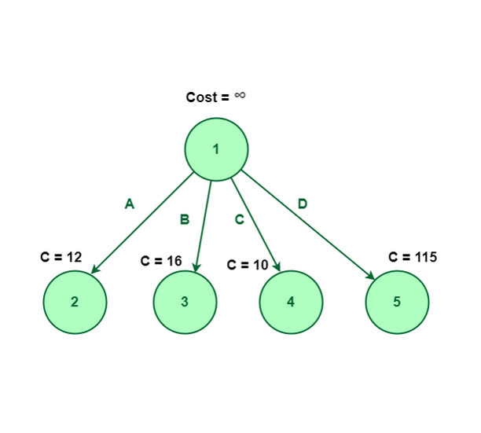
Branch and Bound
The Branch and Bound algorithm does not use a heuristic function — it is a uniform-cost search strategy. That means:
It explores paths in order of their cost from the start.
It does not estimate the remaining cost to the goal.
The code uses Branch and Bound without a heuristic, exploring paths by increasing cost, but fails due to incorrect state transitions using a single environment instance. Its performance is unreliable on FrozenLake unless made deterministic (is_slippery=False) and corrected to simulate transitions properly

Slide 3
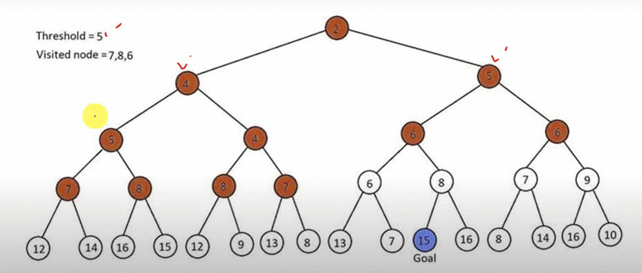
IDA*
Algorithm
The code uses IDA* with a simple Manhattan distance heuristic to solve Taxi-v3 optimally.
It performs depth-limited search iteratively, refining the bound until the goal is found.
Heuristic Function
The heuristic estimates the cost to the goal using Manhattan distance between the taxi's current position and the destination.
It ignores walls, passenger status, and assumes direct movement, making it admissible but not always accurate.
This helps guide the IDA* search toward the destination efficiently, without overestimating cost.

Slide 4
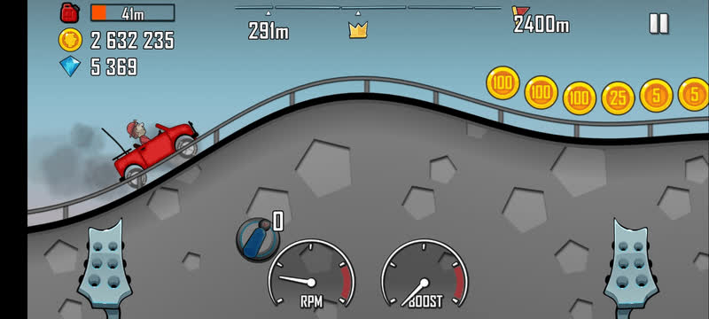
Hill Climbing
Heuristic Function
The heuristic used is the total route distance, calculated by summing the distances between consecutive cities and returning to the start. It directly represents the cost function in the TSP, guiding the hill climbing to minimize the overall tour length. This cost-based heuristic is simple, effective for local improvement, but doesn’t guarantee a global optimum.
Algorithm
The hill climbing algorithm uses route distance as a heuristic to iteratively improve a TSP solution. It’s efficient for small problems but may converge to local minima without escape strategies.

Slide 5
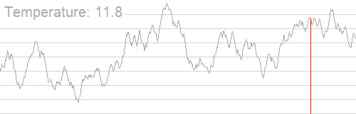
Simulated Annealing
Heuristic Function
Algorithm
The heuristic used is the total tour distance, summing the distances between consecutive cities in the current route and returning to the start.
It serves as the cost function to minimize, guiding the search toward better solutions.
The algorithm also uses a probabilistic acceptance of worse solutions based on temperature, allowing escape from local minima.
Simulated annealing minimizes TSP route cost using total distance as a heuristic and probabilistically accepts worse solutions early on. This helps it explore the search space better than hill climbing and find near-optimal solutions.

Slide 6
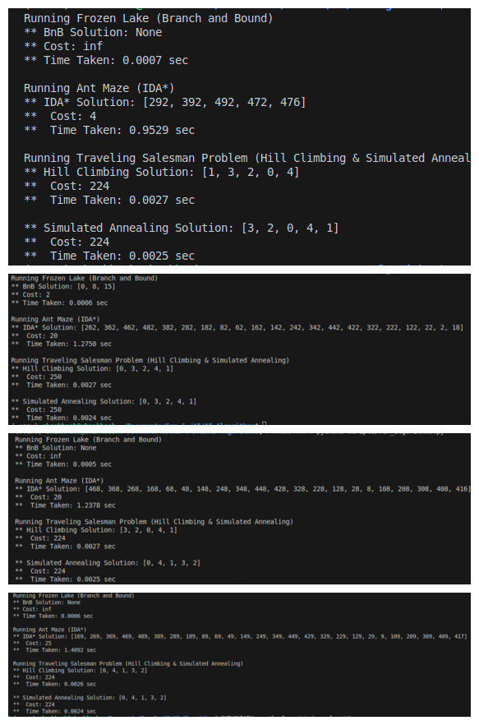
Num of Cities | BnB | IDA* | Hill Climbing | Simulated Annealing
5 | 0.007 | 0.7943 | 0.0024 | 0.0022
10 | 0.0007 | 0.7653 | 0.0025 | 0.0023
15 | 0.0009 | 0.8397 | 0.0024 | 0.0022
20 | 0.0011 | 0.816 | 0.0025 | 0.0023
25 | 0.0009 | 1.1849 | 0.0028 | 0.0025
Time is in the sec
BnB is not reaching in some cases
Perfomance of Algorithms

Slide 7

Thankyou
Assignment-2

